Slide 1
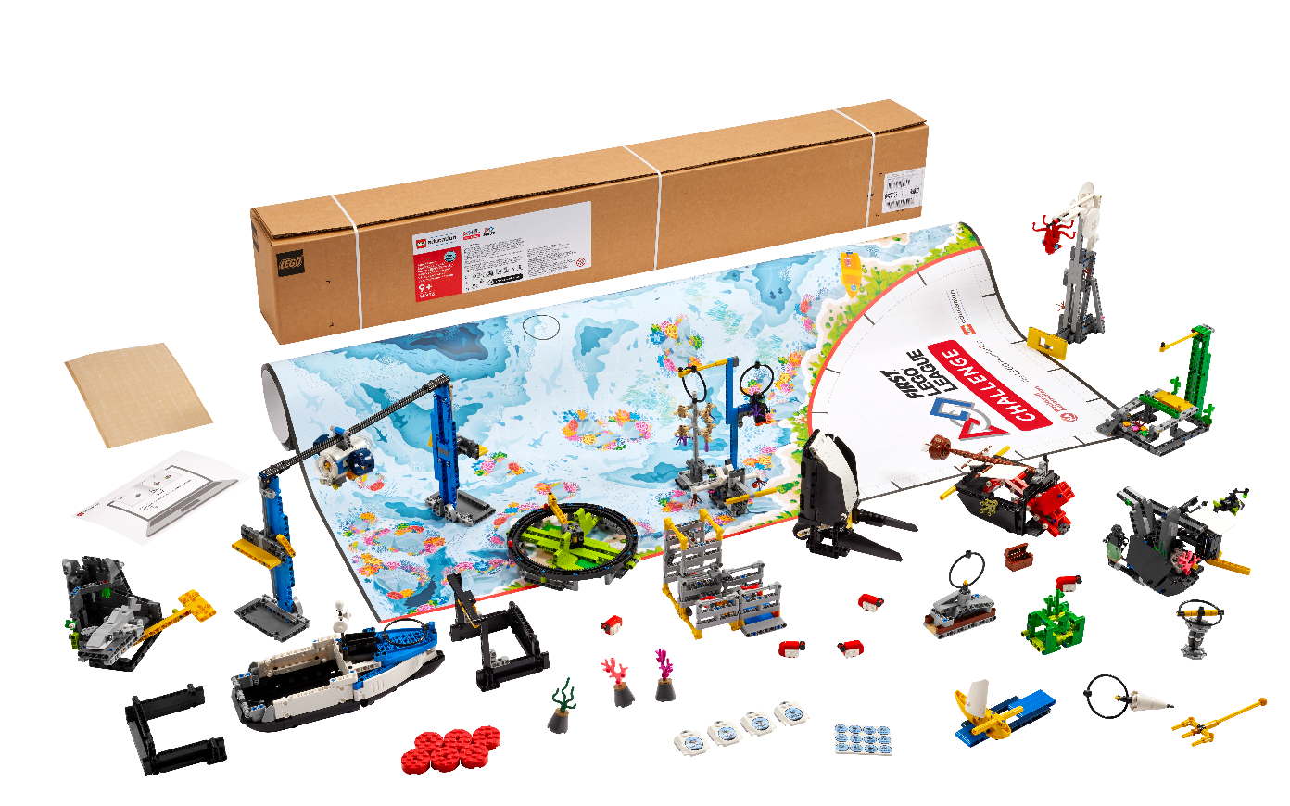


Session 4
Training Camp 3

Slide 2
Session Overview
Outcomes
Narrow down their ideas for their innovation project.
Code their driving base to detect a line using a sensor.
Start to think about their strategy for the robot game.
Notes:
Session Outcomes
Narrow down their ideas for their innovation project.
Code their driving base to detect a line using a sensor.
Start to think about their strategy for the robot game.
Facilitator Tips - Have the team pick a few mission models to highlight and learn about them. Provide resources to the team to learn more about the real-world examples and problems the mission models represent and solve.
Session 4 Tips =
Each team member might not get their favorite problem chosen, but the team should choose something everyone supports.
Plug in the controller and open the app periodically to check for software and firmware updates.
Have the team choose lines on the mat that will help them navigate the robot to different missions.
Have the team follow the program on the screen to see how it matches the robot’s actions. This will help them debug their programs.
Try to start the robot in the same or a very similar place each time in one of the launch areas.

Slide 3
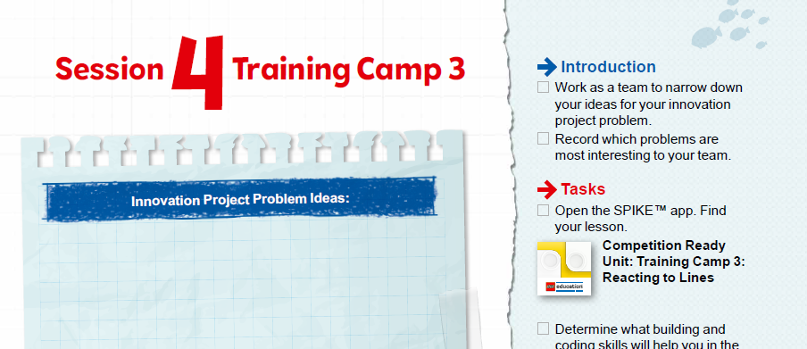

Introduction
Work as a team to narrow down your ideas for your innovation project problem.
Record which problems are most interesting to your team.
Notes:
Session Outcomes
Narrow down their ideas for their innovation project.
Code their driving base to detect a line using a sensor.
Start to think about their strategy for the robot game.
Facilitator Tips - Have the team pick a few mission models to highlight and learn about them. Provide resources to the team to learn more about the real-world examples and problems the mission models represent and solve.
Session 4 Tips =
Each team member might not get their favorite problem chosen, but the team should choose something everyone supports.
Plug in the controller and open the app periodically to check for software and firmware updates.
Have the team choose lines on the mat that will help them navigate the robot to different missions.
Have the team follow the program on the screen to see how it matches the robot’s actions. This will help them debug their programs.
Try to start the robot in the same or a very similar place each time in one of the launch areas.

Slide 4
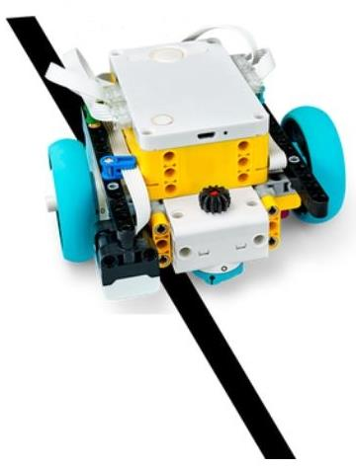

Robot Lesson 4
Open the SPIKE™ Prime app. Find your lesson.
Determine what building and coding skills will help you in the robot game.
Try it out! See if you can use the skills you learned to complete another mission.
Notes:
Team Tasks (100-120 minutes) - Training Camp 3: Reacting to Lines – https://education.lego.com/en-us/lessons/prime-competition-ready/training-camp-3-react-to-lines#lesson-plan
URL for SPIKE on-line: https://spike.legoeducation.com (remember to use a Chrome browser)
Session Outcomes
Narrow down their ideas for their innovation project.
Code their driving base to detect a line using a sensor.
Start to think about their strategy for the robot game.
Facilitator Tips - Have the team pick a few mission models to highlight and learn about them. Provide resources to the team to learn more about the real-world examples and problems the mission models represent and solve.
Session 4 Tips =
Each team member might not get their favorite problem chosen, but the team should choose something everyone supports.
Plug in the controller and open the app periodically to check for software and firmware updates.
Have the team choose lines on the mat that will help them navigate the robot to different missions.
Have the team follow the program on the screen to see how it matches the robot’s actions. This will help them debug their programs.
Try to start the robot in the same or a very similar place each time in one of the launch areas.

Slide 5
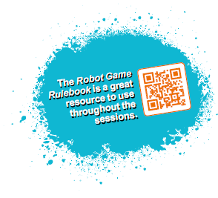
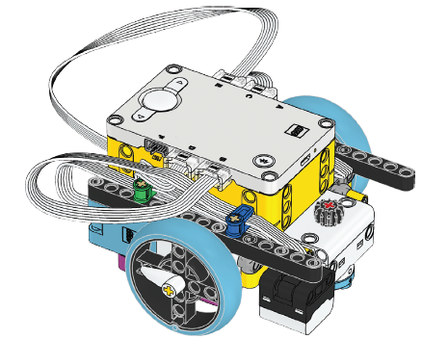
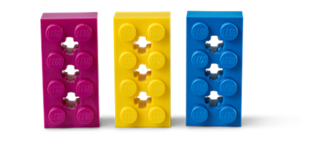

Reflection Questions
How did testing and debugging your program help make your robot more accurate?
Can your robot follow the line from the left launch area to the sound mixer model?
Notes:
Team Tasks (100-120 minutes)
Session Outcomes
Narrow down their ideas for their innovation project.
Code their driving base to detect a line using a sensor.
Start to think about their strategy for the robot game.
Facilitator Tips - Have the team pick a few mission models to highlight and learn about them. Provide resources to the team to learn more about the real-world examples and problems the mission models represent and solve.
Session 4 Tips =
Each team member might not get their favorite problem chosen, but the team should choose something everyone supports.
Plug in the controller and open the app periodically to check for software and firmware updates.
Have the team choose lines on the mat that will help them navigate the robot to different missions.
Have the team follow the program on the screen to see how it matches the robot’s actions. This will help them debug their programs.
Try to start the robot in the same or a very similar place each time in one of the launch areas.

Slide 6
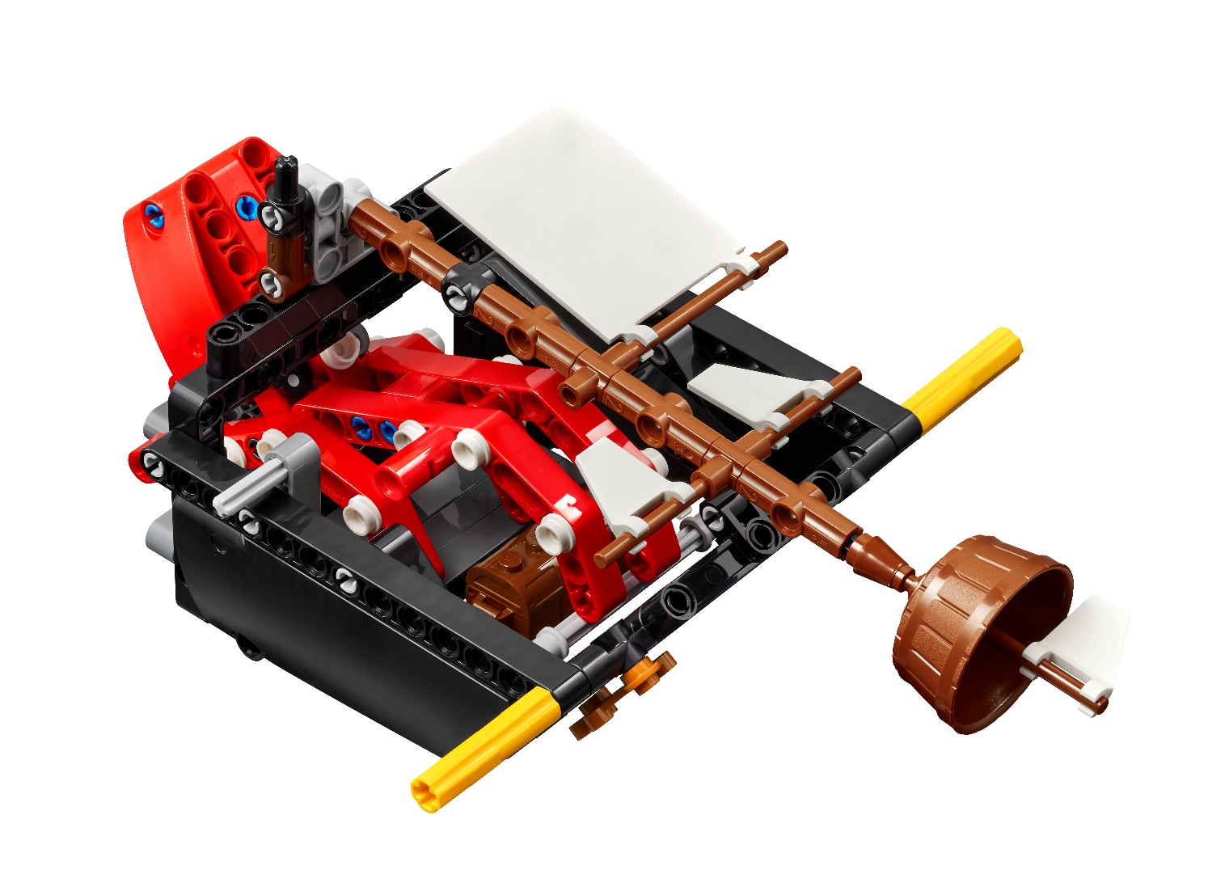

Share
Get together at the mat.
Share the robot skills you learned.
Chat about the reflection questions.
Clean up your space.
Notes:
Share (10-15 minutes)
Session Outcomes
Narrow down their ideas for their innovation project.
Code their driving base to detect a line using a sensor.
Start to think about their strategy for the robot game.
Facilitator Tips - Have the team pick a few mission models to highlight and learn about them. Provide resources to the team to learn more about the real-world examples and problems the mission models represent and solve.
Session 4 Tips =
Each team member might not get their favorite problem chosen, but the team should choose something everyone supports.
Plug in the controller and open the app periodically to check for software and firmware updates.
Have the team choose lines on the mat that will help them navigate the robot to different missions.
Have the team follow the program on the screen to see how it matches the robot’s actions. This will help them debug their programs.
Try to start the robot in the same or a very similar place each time in one of the launch areas.

Slide 7

Reflection Questions
How did testing and debugging your program help make your robot more accurate?
How could you use the lines on the mat in your mission strategy?
What do you want the focus of your innovation project to be?
Notes:
Session Outcomes
Narrow down their ideas for their innovation project.
Code their driving base to detect a line using a sensor.
Start to think about their strategy for the robot game.
Facilitator Tips - Have the team pick a few mission models to highlight and learn about them. Provide resources to the team to learn more about the real-world examples and problems the mission models represent and solve.
Session 4 Tips =
Each team member might not get their favorite problem chosen, but the team should choose something everyone supports.
Plug in the controller and open the app periodically to check for software and firmware updates.
Have the team choose lines on the mat that will help them navigate the robot to different missions.
Have the team follow the program on the screen to see how it matches the robot’s actions. This will help them debug their programs.
Try to start the robot in the same or a very similar place each time in one of the launch areas.

Slide 8

Career Connections

Slide 9

Multimedia Resources
You may wish to embed a relevant, age-appropriate video for your students here.
Notes:
Choose a relevant, age-appropriate video for your students.

Slide 10

Clean Up
Notes:
Allow time for cleanup and place any unfinished models and their pieces in a sealed plastic bag.
Clean Up Pointers
You may wish to play a video or song during clean up time Link on
GoNoodle: https://family.gonoodle.com/activities/clean-up
Link on YouTube Kids: https://www.youtubekids.com/watch?v=ZJFk87ZsHn0
Link on Youtube: https://youtu.be/ZJFk87ZsHn0

Slide 11


LEGO, the LEGO logo, the SPIKE logo, MINDSTORMS and the MINDSTORMS logo are trademarks of the/sont des marques de commerce du/son marcas registradas de LEGO Group. ©2024 The LEGO Group. All rights reserved/Tous droits réservés/Todos los derechos reservados. FIRST ®, the FIRST ® logo, Coopertition ®, Gracious Professionalism®, and FIRST® DIVESM are trademarks of For Inspiration and Recognition of Science and Technology (FIRST). LEGO® is a registered trademark of the LEGO Group. FIRST® LEGO® League and SUBMERGEDSM are jointly held trademarks of FIRST and the LEGO Group. All other trademarks are the property of their respective owners. ©2024 FIRST and the LEGO Group. All rights reserved.

